Slide 1
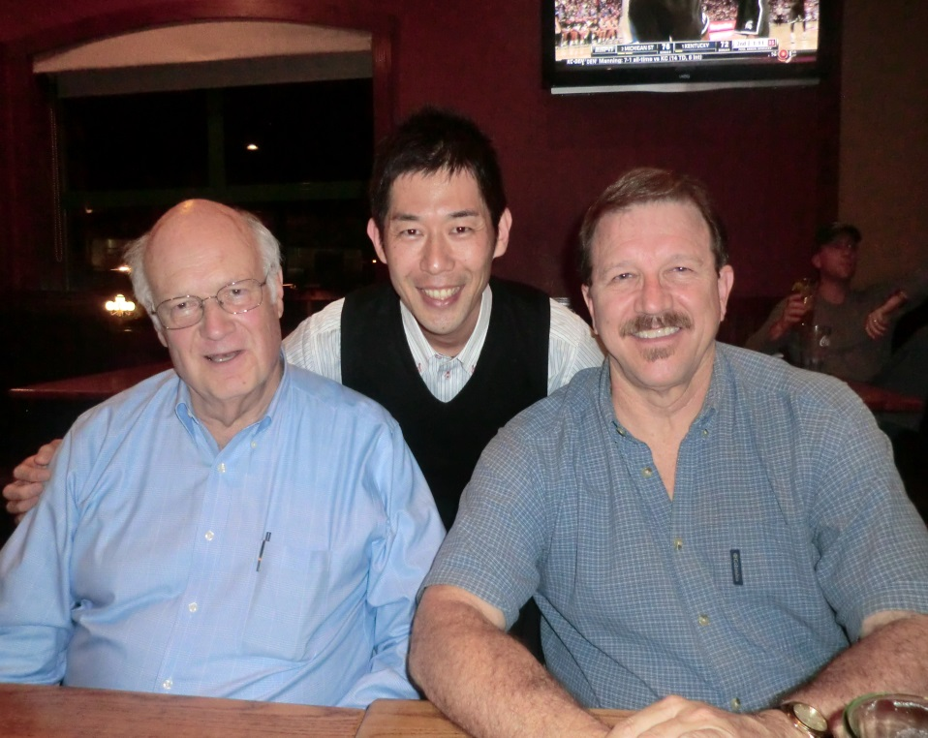
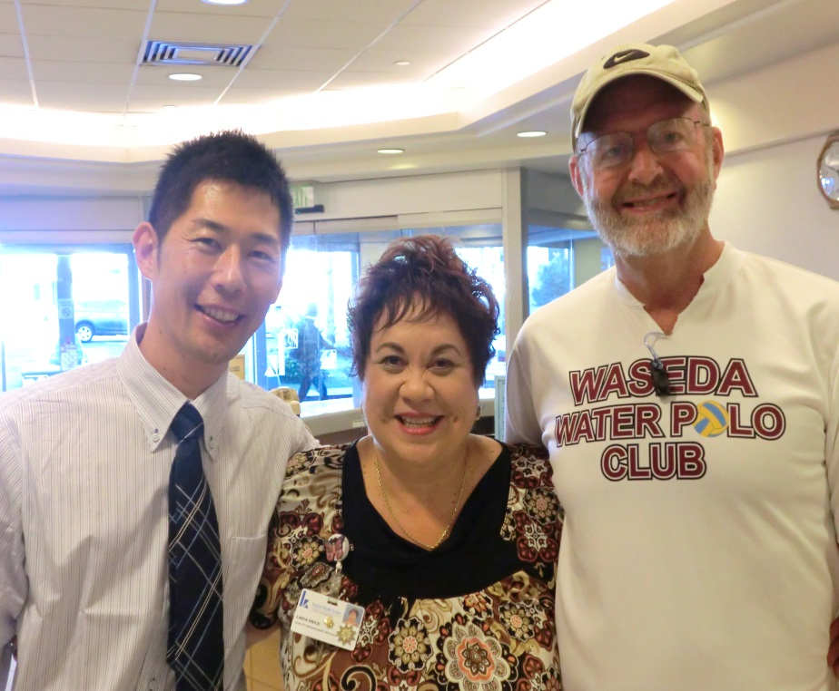
Daisuke Tsukahara
RN, MSN
Japanese Nursing Association
Tokyo, JAPAN
With Conrad in Idaho
With Ron in Hawaii

Slide 2
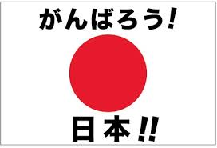
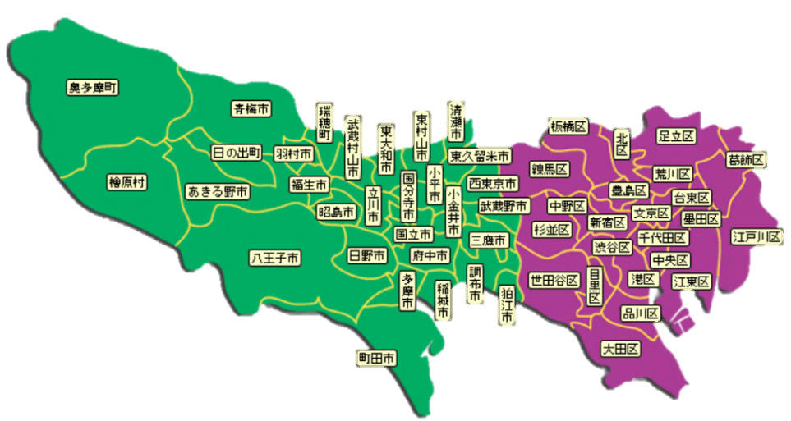
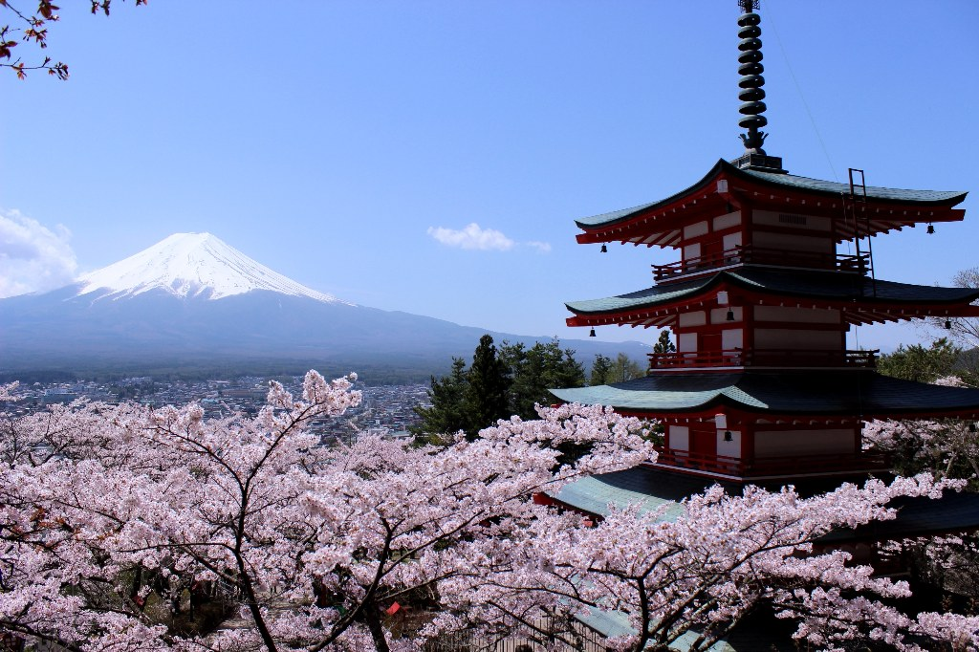
JAPAN
Tokyo

Slide 3
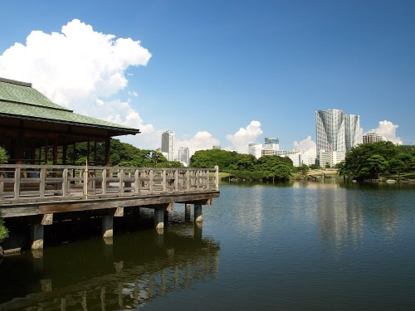
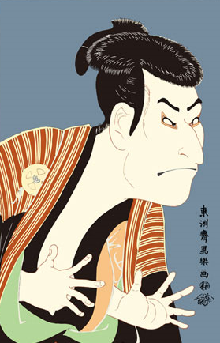
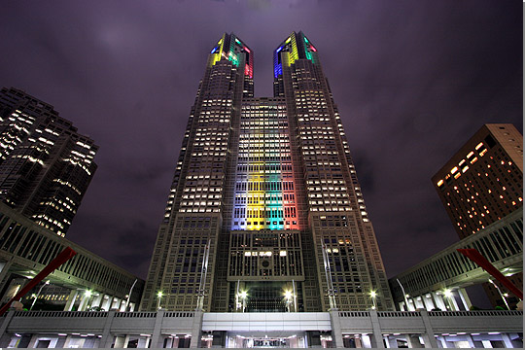
Tokyo
Nature
Culture
Structure

Slide 4
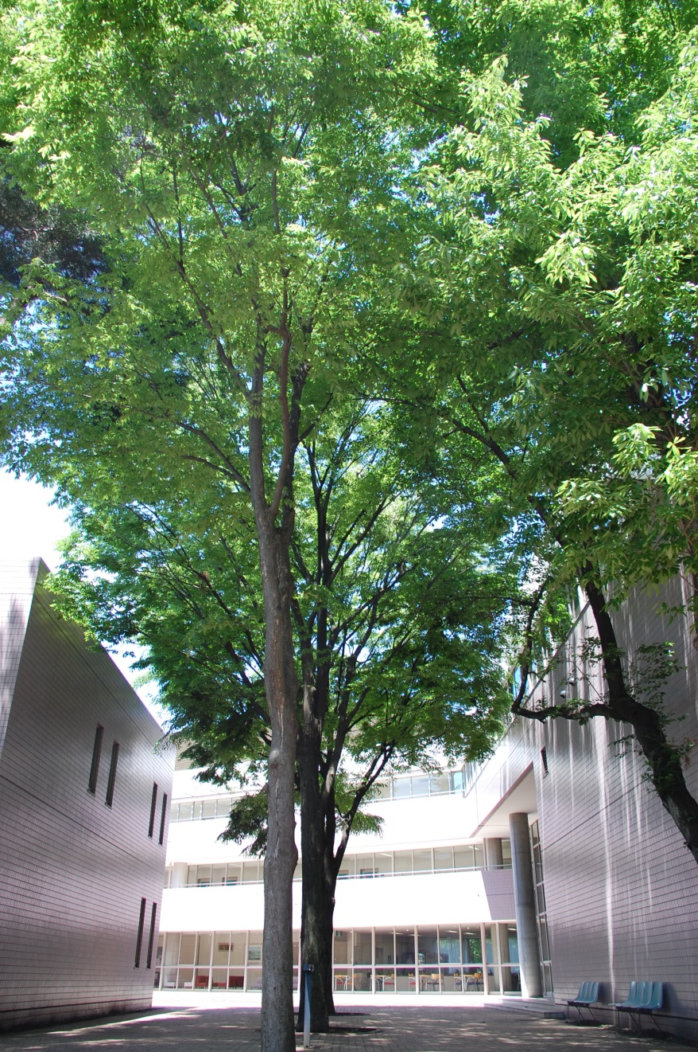
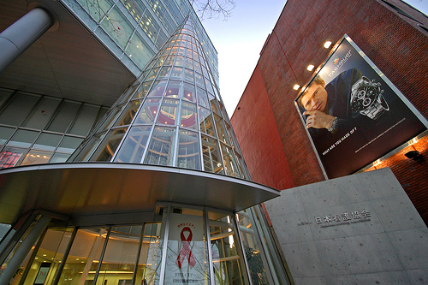
ＪＮＡ
Participation in Policy making
International Activities
Credentialing
Public Relations and Information
Education and Research
Nursing in community
Recruitment and Human Resources

Slide 5
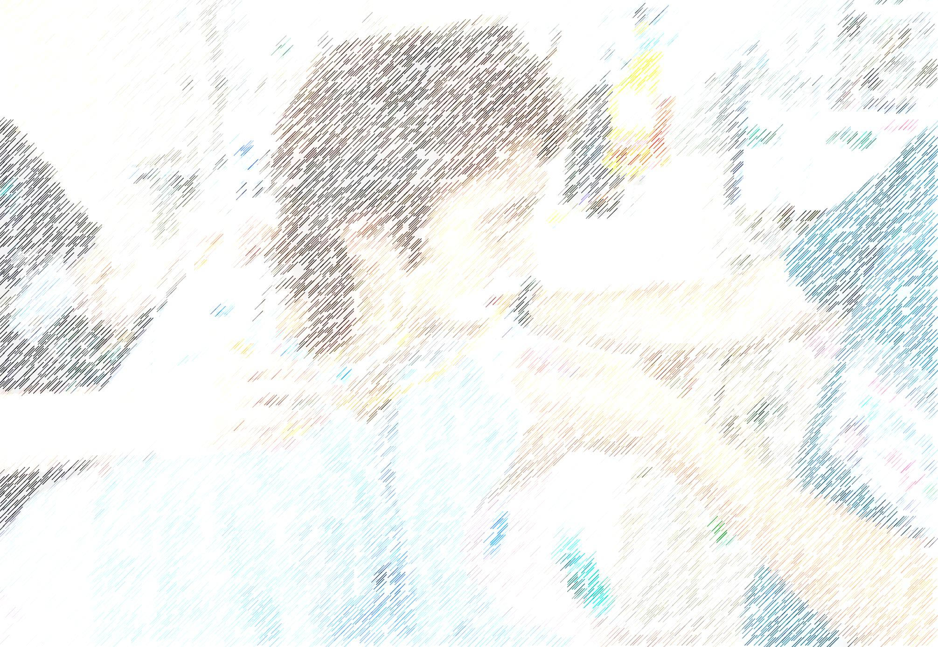
Respiratory Care in Japan
Who Perform Respiratory Care ?
How are they trained ?
What are their responsibility?

Slide 6
Respiratory Care Society in Japan
The Japanese Respiratory Society
The Japanese Society of
Intensive Care Medicine
Japan Society of
Respiratory Care Medicine
The Japan Society for
Respiratory care and Rehabilitation

Slide 7
Names of Host Cities and institutions
Honolulu Hawaii
Castle Medical Center, Kuakini Medical Center
Queen’s Medical Center, Kaiser Permanente Hospital
Kulana Malama(Nursing Home),Apria Healthcare
University of Hawaii Kapiolani community college
Boise Idaho
Saint Alphonsus RMC, Saint Luke’s Hospital
West Valley Medical Center, VA Hospital
Boise state University

Slide 8
What did I value most from Host City visited?
Respiratory Care for patients
Respiratory Care Protocols
Respiratory Care Educations

Slide 9
What valuable information will take back to Japan ?
Respiratory Care for patients
Respiratory Care Protocols
Respiratory Care Educations

